Slide 1
Long Term Hospitalizations Analysis Based on Potential Nosocomial Infections and Other Risk Factors
Hayoung Cheon
Solomon Mathews
Payden Bullis

Slide 2
Define variables
Length of Stay
Hospital ID
Age
Average length of stay (in days)
Identification of a single hospital from the data
Average age of patients (years)
Infection Risk
Routine Culturing Ratio
Routine Chest X-ray Ratio
Average estimated probability of hospital infection
Ratio of # of cultures performed to number of patients without symptoms of infection times 100
Ratio of # of cultures performed to number of patients without symptoms of pneumonia time 100
Notes:
“We are defining the Routine Culturing Ratio and the Routine Chest Xray variables as the number of test per 100 patients, this could be either due to policy, best practice, or “as indicated” by patience risk factors and underlying conditions.” These metrics are commonly used to determine ‘nosocomial’ rates.
nosocomial is a disease originating in a hospital.

Slide 3
Define variables
Number of Beds
Medical School Affiliation
Average Daily Census
Average number of beds in the hospital
Whether or not the hospital is associated with a medical school
Average number of patients in hospital per day
Number of Nurses
Region
Available Facilities
Average number of full-time nurses
Geographic region
Northeast, North Central, South, West
Percent of 35 potential facilities and services that are provided by the hospital
Notes:
Cover these topics quickly, no need to read off the exact text from the boxes.
Geography, region isn’t defined but probably clear with regard to typical understanding of how the US is generally divided.
List of potential Facilities you can read off a few of these not the entire list.
Emergency Care 2. Surgery 3. Maternity Care 4. Pediatrics 5. Cardiology 6. Oncology 7. Neurology 8. Orthopedics 9. Gastroenterology 10. Dermatology 11. Psychiatry 12. Radiology 13. Pathology 14. Anesthesiology 15. Intensive Care Unit (ICU) 16. Rehabilitation Services 17. Physical Therapy 18. Occupational Therapy 19. Speech Therapy 20. Pharmacy 21. Laboratory Services 22. Outpatient Department (OPD) 23. Ward Facilities 24. Nursing Services 25. Medical Imaging (MRI, CT scans) 26. Dialysis 27. Palliative Care 28. Urgent Care 29. Endoscopy 30. Vascular Surgery 31. Plastic Surgery 32. Gynecology 33. Pulmonology 34. ENT (Ear, Nose, and Throat) 35. Specialty Clinics (e.g., diabetes, hypertension)

Slide 5
EDA and Summary Information
Number of Beds
Coefficient: XXXXX T stat: XXXXX P_{value} : XXXXX
Routine Chest X-ray Ratio
Coefficient: XXXXX T stat: XXXXX P_{value} : XXXXX
Medical School Affiliation
Coefficient: XXXXX T stat: XXXXX P_{value} : XXXXX
Infection Risk
Coefficient: XXXXX T stat: XXXXX P_{value} : XXXXX
Routine Culturing Ratio
Coefficient: XXXXX T stat: XXXXX P_{value} : XXXXX
Age
Coefficient: XXXXX T stat: XXXXX P_{value} : XXXXX
Average Daily Census
Coefficient: XXXXX T stat: XXXXX P_{value} : XXXXX
Number of Nurses
Coefficient: XXXXX T stat: XXXXX P_{value} : XXXXX
Region
Coefficient: XXXXX T stat: XXXXX P_{value} : XXXXX
Services Provided
Coefficient: XXXXX T stat: XXXXX P_{value} : XXXXX

Slide 6
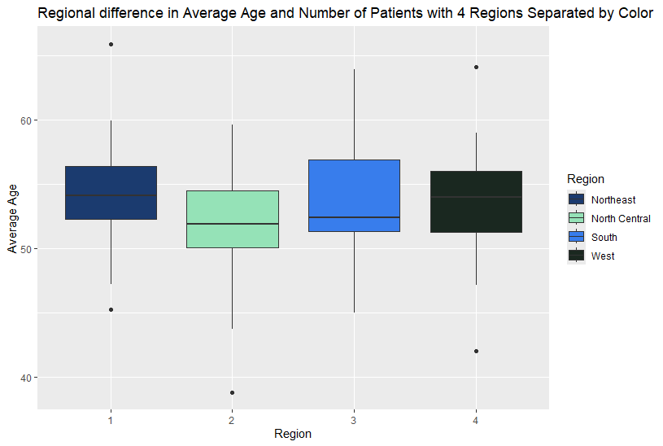
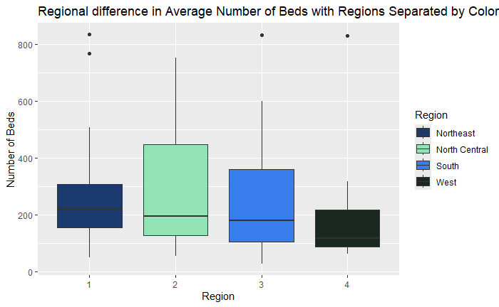
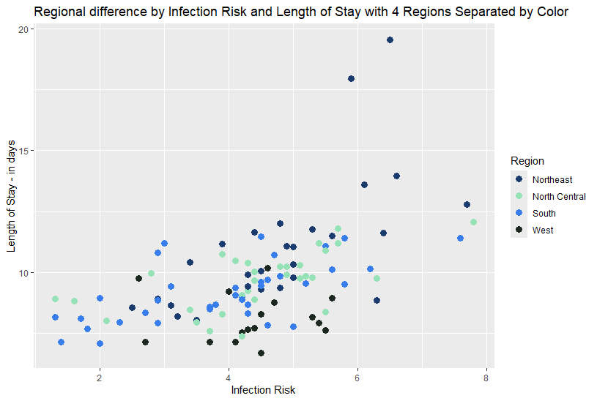
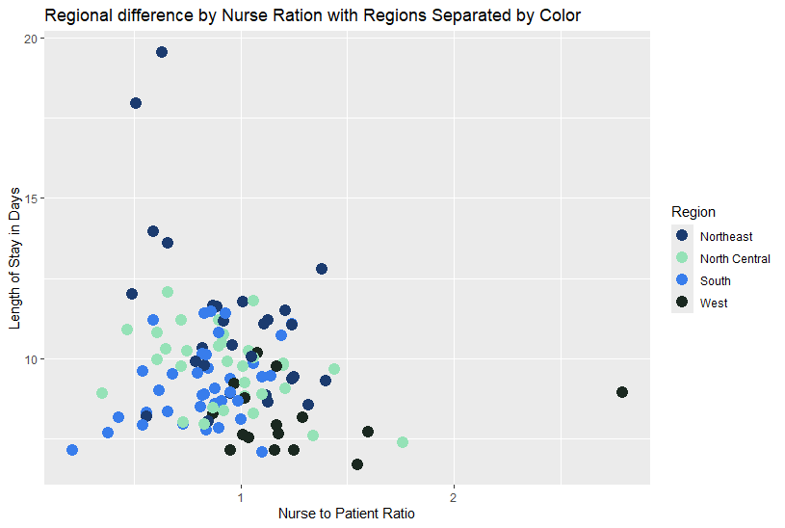

Slide 7
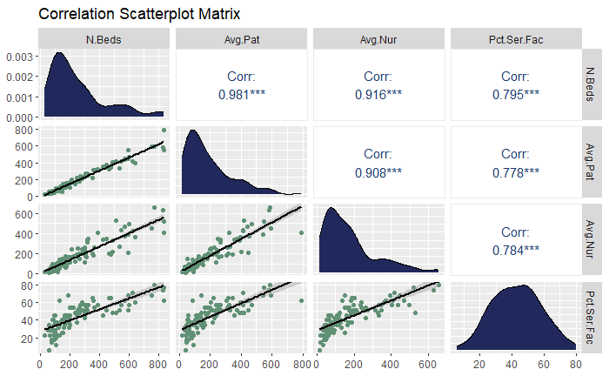
Correlation Matrix with potential Multicollinearity
Notes:
Reviewing the scatter plots for the variables it appears that there are several variables that display some degree of multicollinearity and will need to be addressed during model building.

Slide 8
Objective One
What factors could potentially extend a patient’s stay?
Notes:
For the first objective this model seeks to determine if the infection risk, routine culture rate and routine chest xray are associated with a patients length of stay in a hospital

Slide 9
Objective 1 Summary Table
Infection Risk
Coefficient: XXXXX T stat: XXXXX P_{value} : XXXXX
Routine Chest X-ray Ratio
Coefficient: XXXXX T stat: XXXXX P_{value} : XXXXX
Routine Culturing Ratio
Coefficient: XXXXX T stat: XXXXX P_{value} : XXXXX
Number of Beds
Coefficient: XXXXX T stat: XXXXX P_{value} : XXXXX
Medical School Affiliation
Coefficient: XXXXX T stat: XXXXX P_{value} : XXXXX
Age
Coefficient: XXXXX T stat: XXXXX P_{value} : XXXXX
Average Daily Census
Coefficient: XXXXX T stat: XXXXX P_{value} : XXXXX
Number of Nurses
Coefficient: XXXXX T stat: XXXXX P_{value} : XXXXX
Region
Coefficient: XXXXX T stat: XXXXX P_{value} : XXXXX
Services Provided
Coefficient: XXXXX T stat: XXXXX P_{value} : XXXXX

Slide 10
Definition of Object one
Assumptions and potential issues with the data.

Slide 11
Objective One - conclusion

Slide 12
Objective 2
Outline of the problem and predictions here

Slide 13
Objective 2 – complexity
In the data analysis phase we discovered that (variable) demonstrated a potential polynomial relationship and adjusted them as such

Slide 14
Model Building
Number of Beds
VIF:
(summary of variable and it’s use in the model Y/N)
Routine Chest X-ray Ratio
VIF:
(summary of variable and it’s use in the model Y/N)
Medical School Affiliation
VIF:
(summary of variable and it’s use in the model Y/N)
Infection Risk
VIF:
(summary of variable and it’s use in the model Y/N)
Routine Culturing Ratio
VIF:
(summary of variable and it’s use in the model Y/N)
Age
VIF:
(summary of variable and it’s use in the model Y/N)
Average Daily Census
VIF:
(summary of variable and it’s use in the model Y/N)
Number of Nurses
VIF:
(summary of variable and it’s use in the model Y/N)
Region
VIF:
(summary of variable and it’s use in the model Y/N)
Services Provided
VIF:
(summary of variable and it’s use in the model Y/N)

Slide 15
Objective 2
Assumptions and potential issues with the data. RMSE and other accuracy metric would go here along with Relevant residuals to demonstrate assumptions

Slide 16
Objective 2 - KNN
KNN model and details such as k term and other considerations. Summary of how the knn was built

Slide 17
Objective Two - conclusions

Slide 18
Conclusion

Slide 19
Instructions for use
If you have a free account, in order to use this template, you must credit Slidesgo by keeping the Thanks slide. Please refer to the next slide to read the instructions for premium users.
As a Free user, you are allowed to:
Modify this template.
Use it for both personal and commercial projects.
You are not allowed to:
Sublicense, sell or rent any of Slidesgo Content (or a modified version of Slidesgo Content).
Distribute Slidesgo Content unless it has been expressly authorized by Slidesgo.
Include Slidesgo Content in an online or offline database or file.
Offer Slidesgo templates (or modified versions of Slidesgo templates) for download.
Acquire the copyright of Slidesgo Content.
For more information about editing slides, please read our FAQs or visit Slidesgo School:
https://slidesgo.com/faqs and https://slidesgo.com/slidesgo-school

Slide 20
Instructions for use (premium users)
As a Premium user, you can use this template without attributing Slidesgo or keeping the "Thanks" slide.
You are allowed to:
Modify this template.
Use it for both personal and commercial purposes.
Hide or delete the “Thanks” slide and the mention to Slidesgo in the credits.
Share this template in an editable format with people who are not part of your team.
You are not allowed to:
Sublicense, sell or rent this Slidesgo Template (or a modified version of this Slidesgo Template).
Distribute this Slidesgo Template (or a modified version of this Slidesgo Template) or include it in a database or in any other product or service that offers downloadable images, icons or presentations that may be subject to distribution or resale.
Use any of the elements that are part of this Slidesgo Template in an isolated and separated way from this Template.
Register any of the elements that are part of this template as a trademark or logo, or register it as a work in an intellectual property registry or similar.
For more information about editing slides, please read our FAQs or visit Slidesgo School:
https://slidesgo.com/faqs and https://slidesgo.com/slidesgo-school

Slide 21
Use our editable graphic resources...
You can easily resize these resources without losing quality. To change the color, just ungroup the resource and click on the object you want to change. Then, click on the paint bucket and select the color you want. Group the resource again when you’re done. You can also look for more infographics on Slidesgo.

Slide 24
JANUARY
FEBRUARY
MARCH
APRIL
MAY
JUNE
PHASE 1
Task 1
Task 2
PHASE 2
Task 1
Task 2
JANUARY
FEBRUARY
MARCH
APRIL
PHASE 1
Task 1
Task 2

Slide 27
...and our sets of editable icons
You can resize these icons without losing quality.
You can change the stroke and fill color; just select the icon and click on the paint bucket/pen.
In Google Slides, you can also use Flaticon’s extension, allowing you to customize and add even more icons.

Slide 28
Educational Icons
Medical Icons

Slide 29
Business Icons
Teamwork Icons

Slide 30
Help & Support Icons
Avatar Icons

Slide 31
Creative Process Icons
Performing Arts Icons

Slide 32
Nature Icons

Slide 33
SEO & Marketing Icons

Slide 34


